Slide 1
How AVID can help you create the life of your dreams

Slide 2
Do you have a plan to go to college?

Slide 3
Do the people around you see your potential?

Slide 4
Agenda
A
What is AVID
How does it help students
A day in the life of an AVID student
Who is the perfect candidate
How to apply

Slide 5
The AVID opportunity at Odyssey Charter Jr./Sr. High School
The mission of AVID is to close the opportunity gap by preparing all students for college and career readiness and success in a global society.

Slide 6
What is AVID?
Advancement Via Individual Determination

Slide 7
People Like Me

Slide 9
How does AVID support students?
Advancement Via Individual Determination

Slide 10
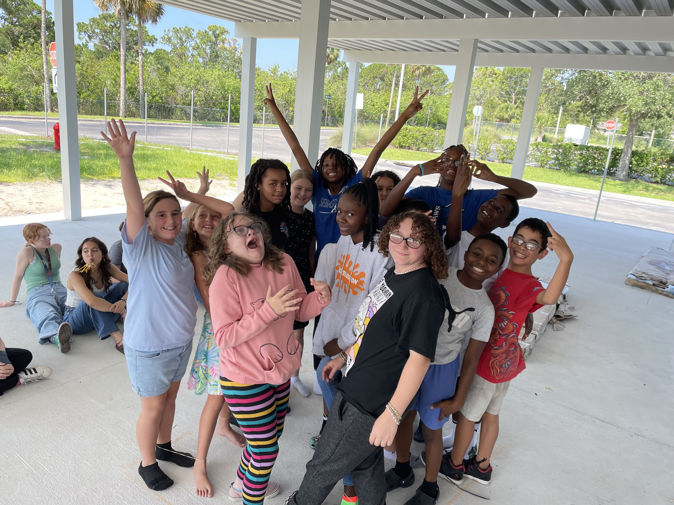
Family

Slide 11
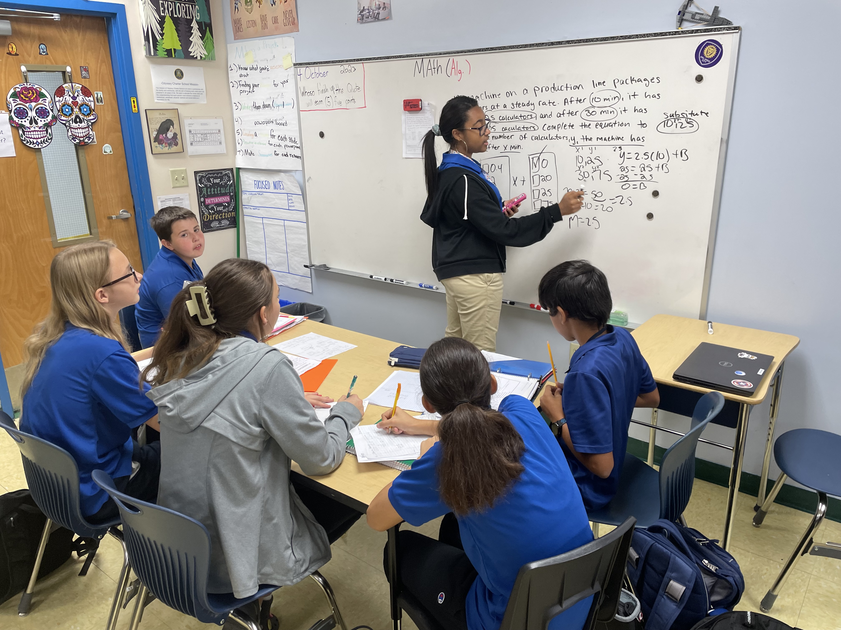
Tutorials

Slide 12
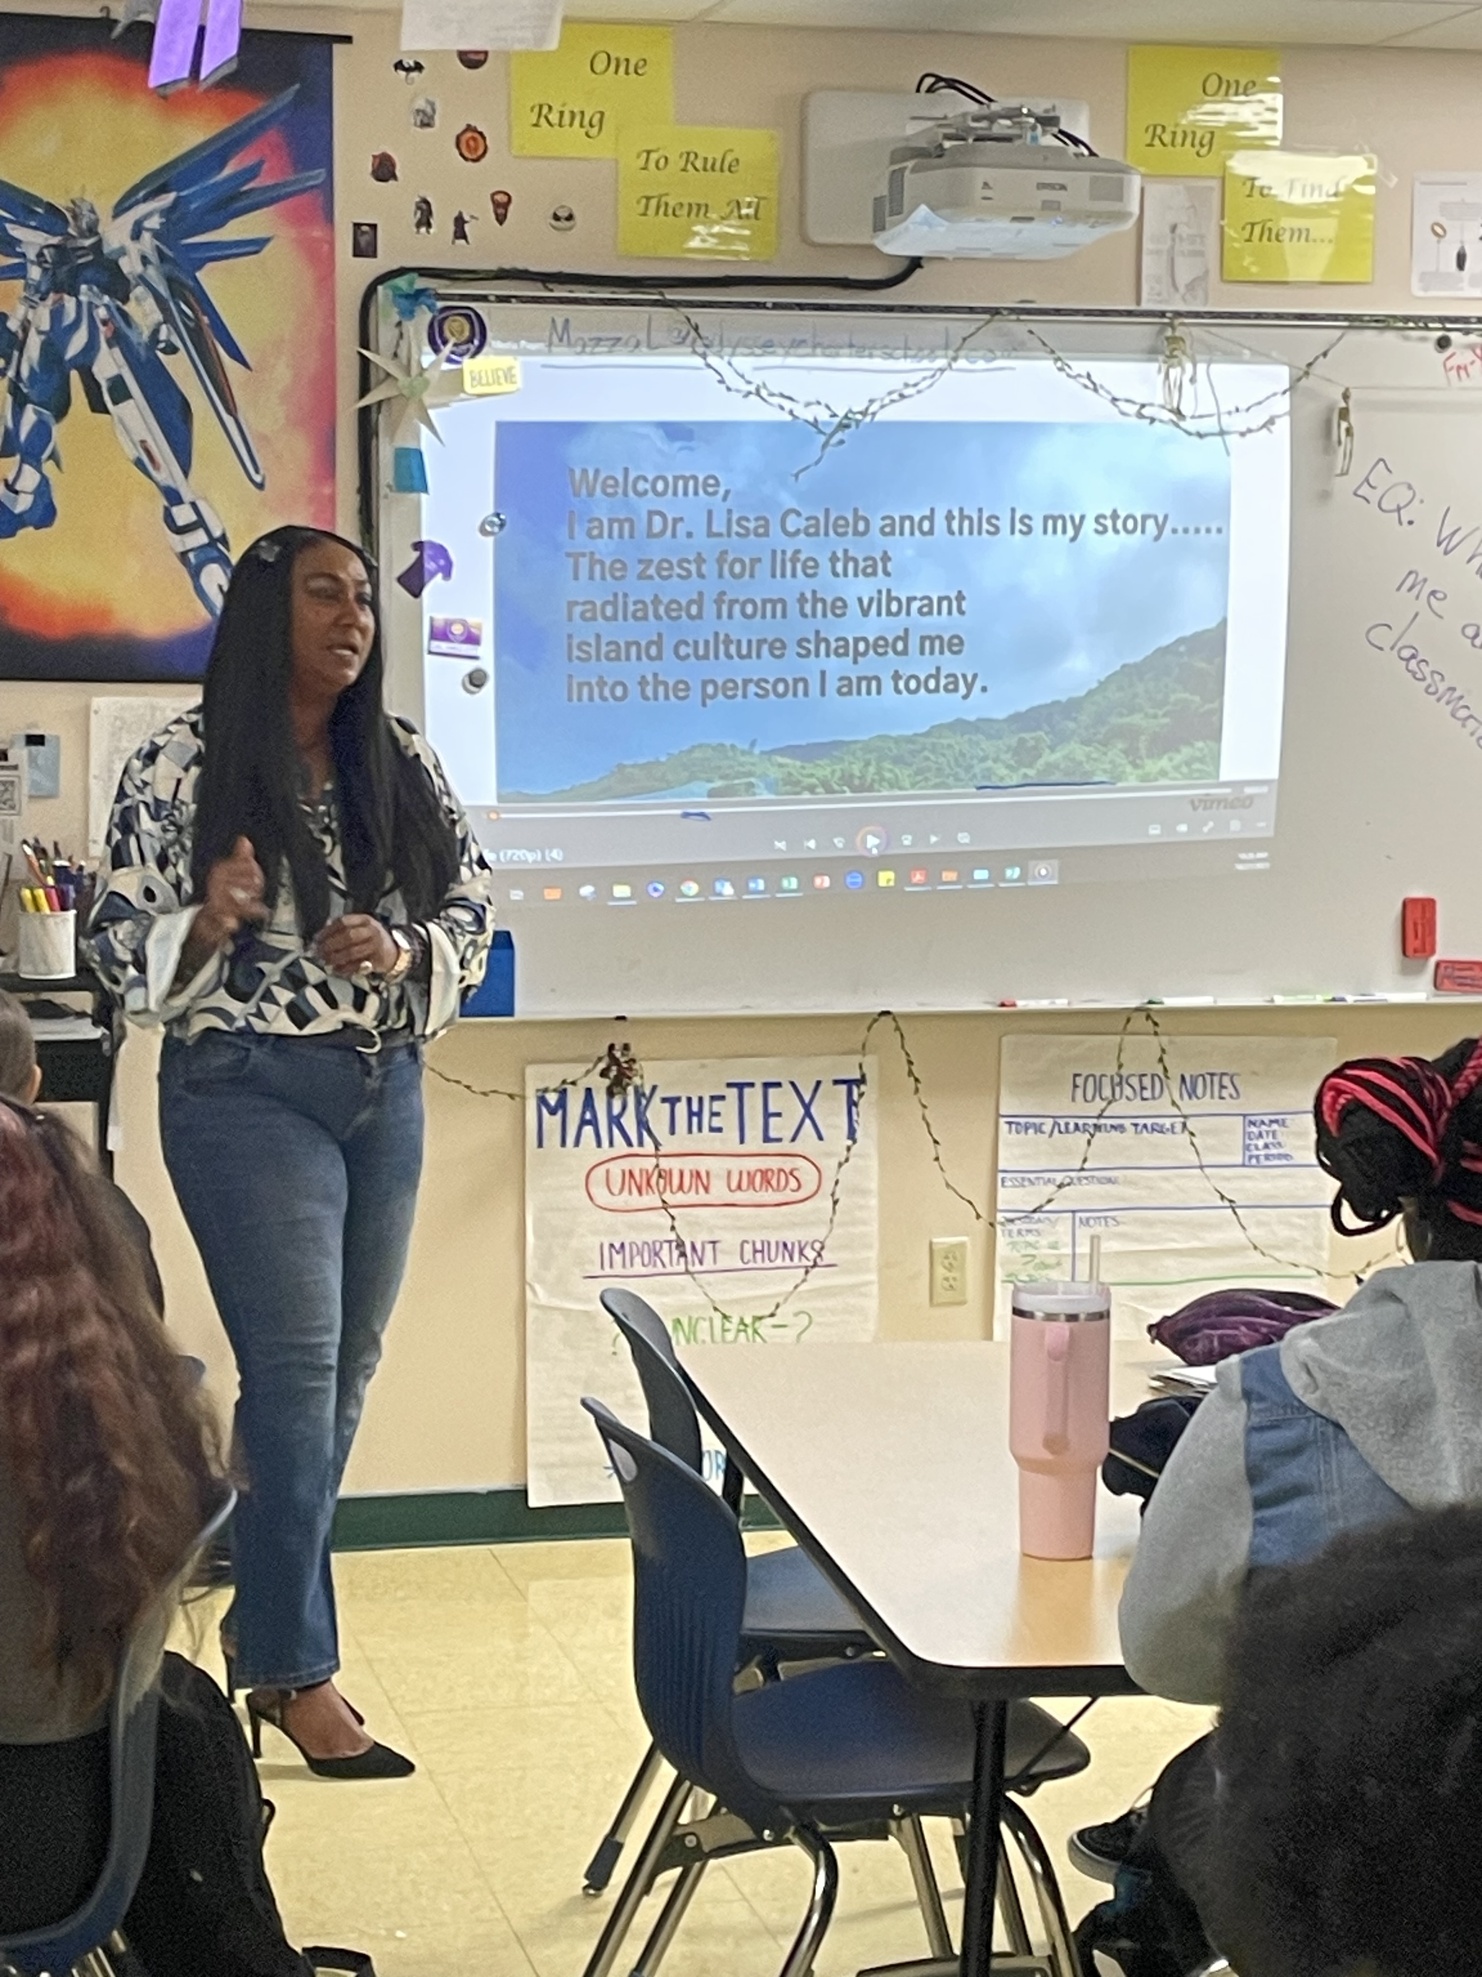
Lessons connected to real life

Slide 13
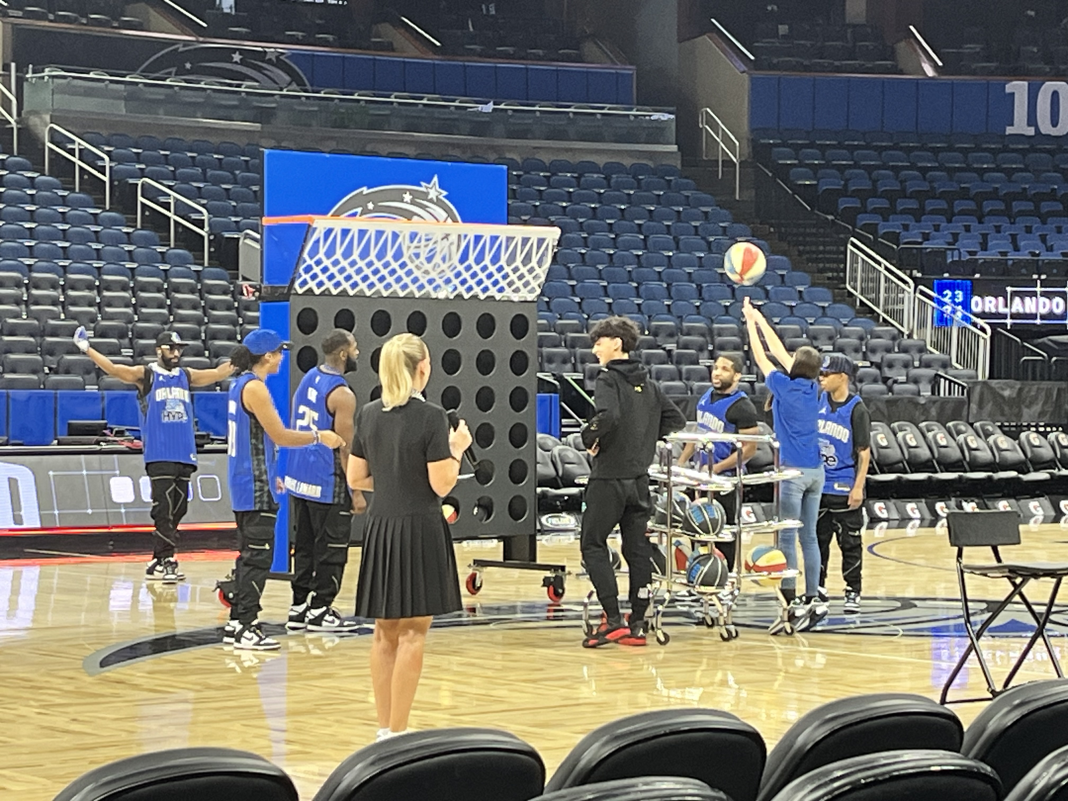
College visits

Slide 14
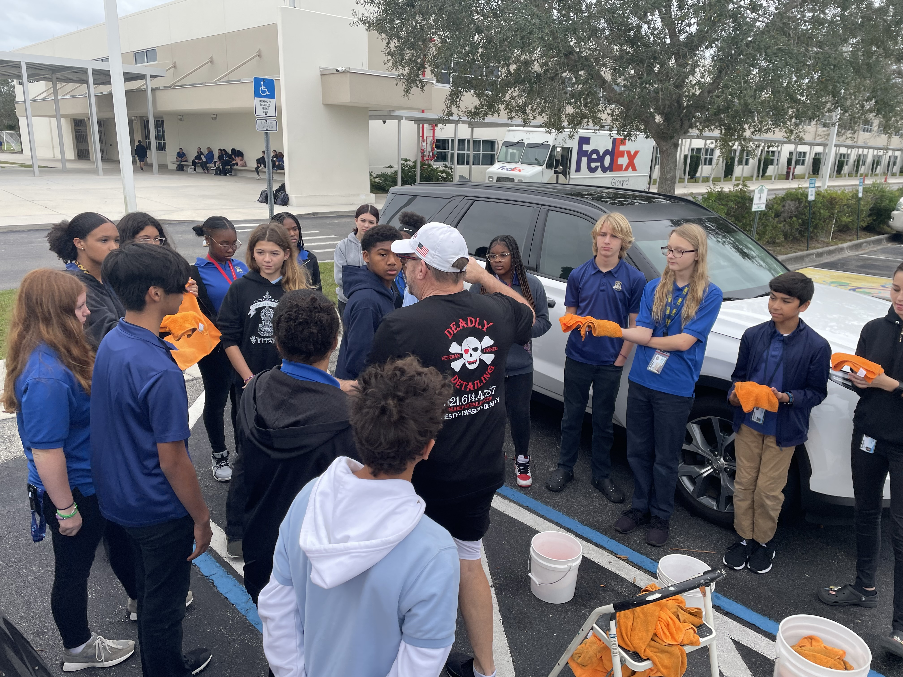
Community Service Projects

Slide 15
What does a day in the life of an AVID student look like?
Advancement Via Individual Determination

Slide 16
A Sample Week in the AVID Elective
16
Daily Schedule
Monday | Tuesday | Wednesday | Thursday | Friday
AVID Curriculum | Tutorials | AVID Curriculum | Tutorials | Binder Evaluation College Visits Speakers Motivational Activities
AVID curriculum supports writing, inquiry, collaboration, organization, and reading, as well as study skills and leadership skills.
AVID tutorials are a college-like study group where students come with complex questions from any class and get guided support, learning how to solve future problems.

Slide 17
Who is the perfect candidate to be an AVID student?
Advancement Via Individual Determination

Slide 18
Wants to attend college and is willing to work hard to achieve success
Other criteria can include:
Average grades- 2.0-3.5 GPA
Attend school most days
No or few referrals
Low motivation
Test scores between level 2-4
Non traditional family structure
Ethnicity under-represented in college
First generation college student

Slide 19
How do you apply to AVID?
Advancement Via Individual Determination

Slide 20
Steps to apply
1. Learn about AVID
2. Complete an application
3. Schedule your interview
Do you know any AVID students?
Go to our website to view videos and other information
Talk to your family about your plans for life after high school
What do you know about getting into college
6 page packet
Pages 1-3 are for you to fill out telling us more about you so we can see how AVID will help you
Page 4 for parents/guardians
Pages 5-6 you give to your teachers
Interviews will be held at Eldron March 11-21
7:45-8:30
4:15-5:30
Each interview will be 15 long
Dress to impress

Slide 21
Questions for the Student Panel of current AVID students

Slide 22
AVID Team Builder A few of you can volunteer to see how we learn in AVID by taking part in a live demonstration.
Participants- How can you connect this activity to life in school?
Audience- What things are the participants learning that can be used in adult life?

Slide 23
We look forward to meeting you at your interview!

Slide 24
Quarterly performance

Slide 25
Areas of growth
 | B2B | Supply chain | ROI | E-commerce
Q1 | 4.5 | 2.3 | 1.7 | 5.0
Q2 | 3.2 | 5.1 | 4.4 | 3.0
Q3 | 2.1 | 1.7 | 2.5 | 2.8
Q4 | 4.5 | 2.2 | 1.7 | 7.0

Slide 26
Business opportunities are like buses. There's always another one coming.
“
”
Richard Branson

Slide 27
Meet our team
Takuma Hayashi​
Mirjam Nilsson​
Flora Berggren​
Rajesh Santoshi​
President
Chief Executive Officer
Chief Operations Officer
VP Marketing

Slide 28
Meet our extended team
Takuma Hayashi​
Mirjam Nilsson​
Flora Berggren​
Rajesh Santoshi​
President
Chief Executive Officer
Chief Operations Officer
VP Marketing
Graham Barnes
Rowan Murphy
Elizabeth Moore
Robin Kline
VP Product
SEO Strategist
Product Designer
Content Developer

Slide 29
Plan for product launch
Deploy strategic networks with compelling e-business needs
Planning
Synergize scalable e-commerce
Marketing
Disseminate standardized metrics
Design
Coordinate e-business applications
Foster holistically superior methodologies
Launch
Strategy

Slide 30
Timeline
Deploy strategic networks with compelling e-business needs
Sep 20XX
Synergize scalable e-commerce
Nov 20XX
Disseminate standardized metrics
Jan 20XX
Coordinate e-business applications
Mar 20XX
Foster holistically superior methodologies
May 20XX

Slide 31
Areas of focus
F
B2B market scenarios
Develop winning strategies to keep ahead of the competition
Capitalize on low-hanging fruit to identify a ballpark value
Visualize customer directed convergence
Cloud-based opportunities
Iterative approaches to corporate strategy
Establish a management framework from the inside

Slide 32
How we get there
ROI
Niche markets
Supply chains
Envision multimedia-based expertise and cross-media growth strategies
Visualize quality intellectual capital
Engage worldwide methodologies with web-enabled technologies
Pursue scalable customer service through sustainable strategies
Engage top-line web services with cutting-edge deliverables
Cultivate one-to-one customer service with robust ideas
Maximize timely deliverables for real-time schemas

Slide 33
Summary
At Contoso, we believe in giving 110%. By using our next-generation data architecture, we help organizations virtually manage agile workflows. We thrive because of our market knowledge and great team behind our product. As our CEO says, "Efficiencies will come from proactively transforming how we do business."

Slide 34
Thank you
Mirjam Nilsson​
mirjam@contoso.com
www.contoso.com

